Slide 1

Apache Karaf
Dima Ionut Daniel

Slide 2
Contents
What is Apache Karaf?
Apache Karaf Features
Architecture
Runtime
JMX Console
Provisioning
System Configuration
Deploy Applications
Apache Karaf Cellar
Conclusions
Bibliography

Slide 3

What is Apache Karaf?
Apache Karaf is an opensource subproject of Apache Felix.
Apache Karaf is a small OSGI based runtime which provides a lightweight container.
Karaf 3.0.x supports OSGI 4.3 containers: Apache Felix 4 and Eclipse Equinox 3.8.

Slide 4
Apache Karaf Features
Hot deployment: supports hot deployment of OSGI bundles by monitoring directory.
Dynamic Configuration: services are configures using ConfigurationAdmin OSGI service.
Logging System: support for Log4j, Slf4j.
Provisioning: libraries can be downloaded locally.
Native OS integrtion: can be integrated with OS as service.
Extensible Shell console: text console for managing services.
Remote access: use any SSH client to connect to Karaf and issue commands in console
Security framework: based on JAAS.
Managing instances: provides single commands for managing multiple instances.

Slide 5
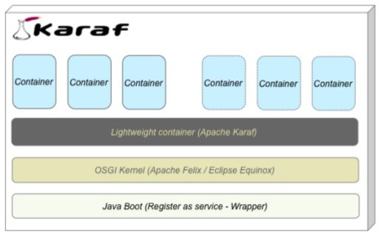
Architecture
Platform running on OSGI: Apache Felix, Eclipse Equinox.
Provides a lightweight container.
Used by ServiceMix, Geronimo,etc.

Slide 6
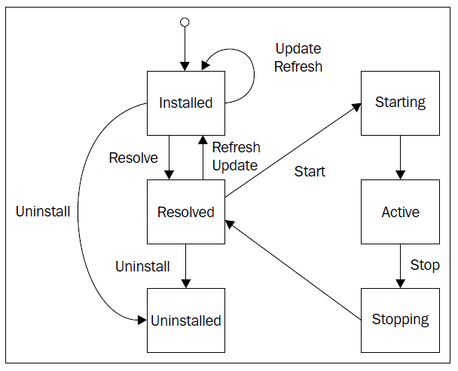
Runtime
Apache Karaf, as an OSGI runtime container handles OSGI bundle lifecycle.

Slide 7
Runtime (cont.)
Apache Karaf commands:
Install: installs bundles to container.
Uninstall: uninstalls a bundle via bundle ID.
Start: starts a bundle.
Stop: stops a bundle via bundle ID.
Resolve: instructs the container to attempt to wire all required dependencies.
Refresh: refreshes a bundle’s wiring; the container will recalculate dependencies.
Update: bundle is reinstalled and rewired.
List: displays bundles/artifacts deployed.
Info: displays system information of Karaf instance.
Headers: display bundle’s manifest file.
Imports: displays imported packages.
Exports: displays exported packages.
Framework: selects OSGI framework for the container.
Restart: restarts the container.
Shutdown : stops Karaf instance.

Slide 8
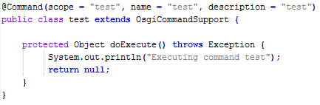
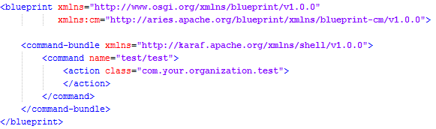
Runtime (cont.)
We can create bundle that extends the Karaf’s OsgiCommandSupport and define in the OSGI container custom commands that will be used in as Gogo Command.
In the OSGI-INF/blueprint we define the shell-log.xml descriptor file that will associate the command with the actual implementation.

Slide 9
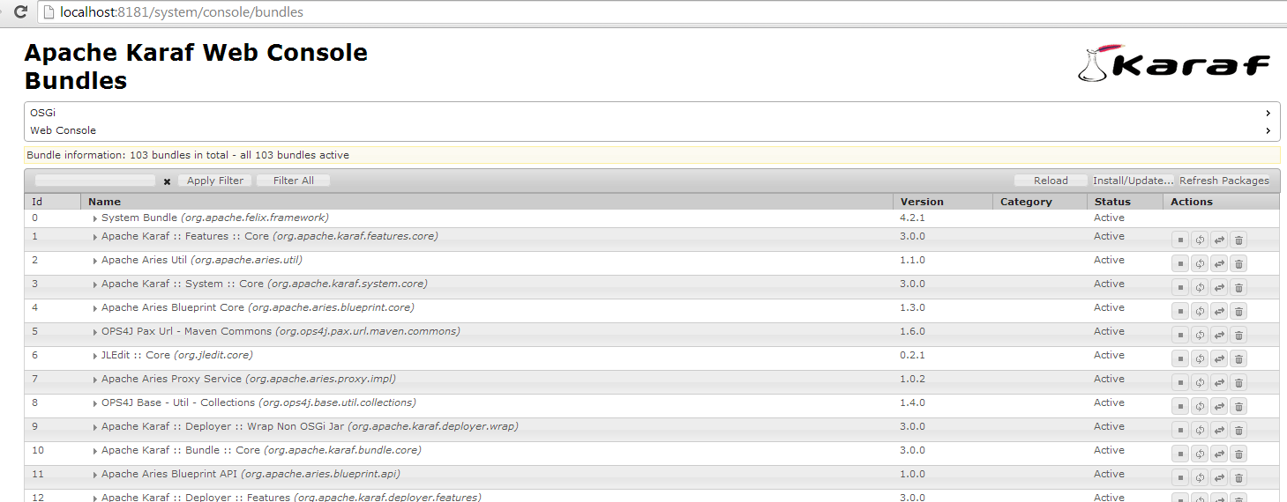
JMX Console
In addition to Karaf shell, JMX is also provided.
The following Mbeans can be monitored.
Also the web console can be installed by running: “feature:install webconsole“ in the Karaf shell.

Slide 10
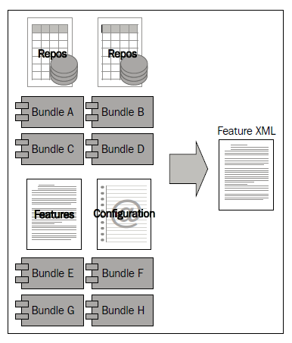
Provisioning
To accomplish the maven resolution, Karaf uses a subproject from OPS4J Pax URL.
Pax URL provides a set of URL handlers that can be used in both OSGi and regular java environments.
Karaf provides a second “system” repository, a simplified maven layout directory that uses Pax URL.
Apache Karaf provides a mechanism to build applications or more complex deployment descriptors.
The feature command is used for installing, removing, updating features.

Slide 11
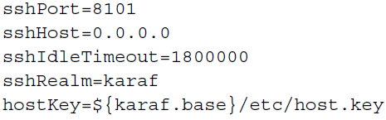
System Configuration
The remote SSH access is configured in etc/org.apache.karaf.shell.cfg file.
Default configuration is shown bellow:
The logging system for Karaf is based on OPS4J Pax Logging and backend uses Log4j.
The OPS4J Pax Logging system is a standard OSGi logging framework that supports API’s:
Apache Log4j
Apache Commons Logging
SLF4j
Java Util Logging
Karaj is writing to the log/karaf.log.
The log file location can be updated by log4j.appender.out.file.

Slide 12
System Configuration (cont.)
The log level can be retrieved using log:get in Karaf interctive shell.
In order to set the log level: log:set LEVEL [package] .
The main system property file is etc/config.properties.
The karaf.framework property defines the OSGI container: felix, equinox.

Slide 13
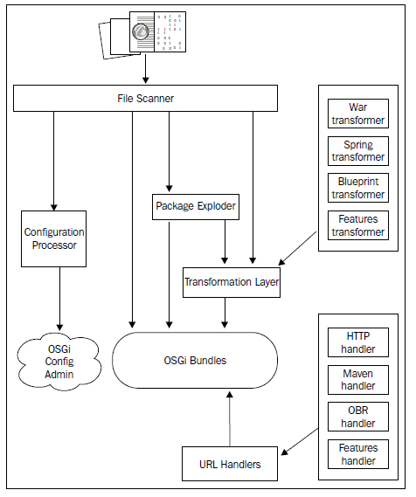
Deploy Applications
A bundle is a Jar file with an OSGI-compatible manifest file.
Maven uses Apache Felix Bundle Plugin to assemble and define the bundle based on XML Configuratons.
The Felix Bundle Plugin utilizes the BND tool wich can be used from command line.
The installation of a bundle can be done by copying the bundle to [karaf]/deploy directory or by using the install command from Karaf shell.

Slide 14
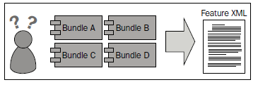
Deploy Applications (cont.)
Feature decriptors are XML files that describe how to deploy a group of bundles or other features.
A feature file can be deployed in the following ways:
Deployed as a bundle
Dropped in the Hot Deploy directory
Referenced on startup
Feature commands: feature:install, feature:uninstall, feature:list, etc.

Slide 15
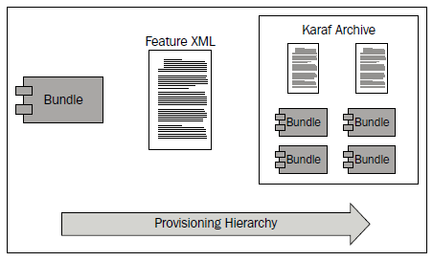
Deploy Applications (cont.)
Karaf supports the wrap protocol that provides the ability to alter a JAR to be OSGI-compliant.
The wrap protocol is automatically invoked by rewriting the manifest file.
Deploying a WAR file is also supported within the Karaf container.
The war feature needs to be installed first.
A Karaf Archive(KAR) is basically a JAR file that contains feature descriptors and bundle JARs as a deployment unit.

Slide 16
Deploy Applications (cont.)
Maven can be used to assemble the KAR easz as creating a bundle.
The purpose of the KAR archive is to perform the followingŞ
Read the feature descriptors for all feature definitions
Resolve the bundles defined bz the features
Package all bundles, configuration and dependencies required bz the features.

Slide 17
Apache Karaf Cellar
Apache Karaf has a clustering solution.
Apache Cellar is used to provide a clustering solution prowered bz Hazelcast.
The core concept behind Cellar is that each Karaf instance is a node that can be deployed as part of a group.
Features:
Node discovery
Cluster groups
Distributed configuration admin, features and bundles
Cloud discovery
Cellar is not part of the default installation provided by Karaf.

Slide 18
Conclusions
Apache Karaf is a light OSGi based container runtime easy to use.
Apache Karaf is documented.
Apache Karaf supports multiple types of deployment units.

Slide 19

Bibliography
http://karaf.apache.org/
PacktPub - Learning Apache Karaf

